Slide 1
Understanding Data, Preprocessing and Exploration
Dr. Zhe Jiang
Department of Computer & Information Science & Engineering
University of Florida
Email: zhe.jiang@ufl.edu
Website: https://www.jiangteam.org/

Slide 2
Outline
What is data?
How to view data as a data scientist?
Preprocessing and data cleaning
Feature selection, extraction, engineering
Exploring data characteristics

Slide 3
What is Data?
Merriam-Webster definition:
Data: factual information (e.g., measurements, statistics) used as a basis for reasoning, discussion, or calculation
We focus on digitalized data in computational devices
Source of data
Natural phenomenon (e.g., temperature, precipitation)
Human activity (e.g., web-click, GPS trajectory, email)
Simulation (e.g., climate model, Nuclear weapon)
Can you give examples of non-data?
Notes:
How computer represent data, how to categorize data from data analysis perspective?

Slide 4
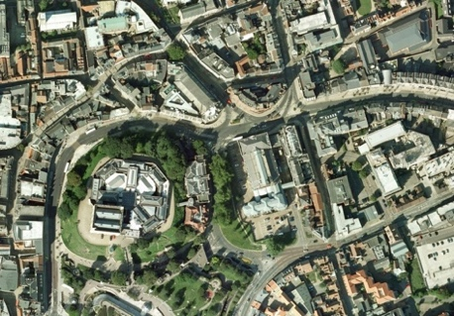






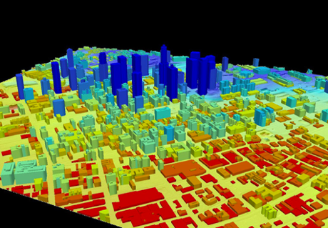
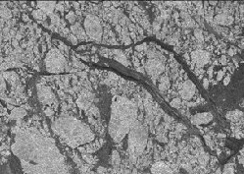



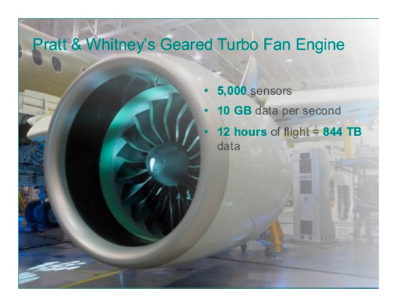
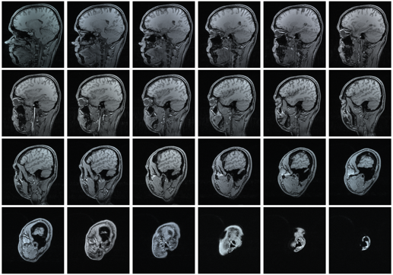

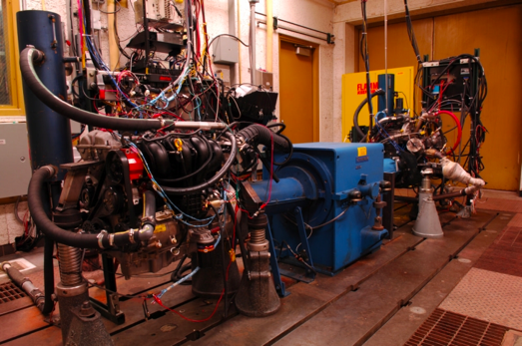
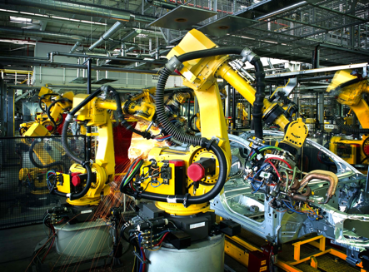

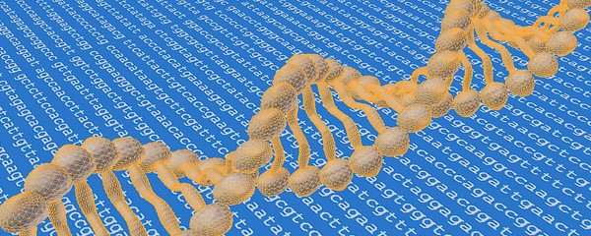
Types of Data: By Applications
Internet data
Earth observation data
Manufacture sensor data
Healthcare data

Slide 5
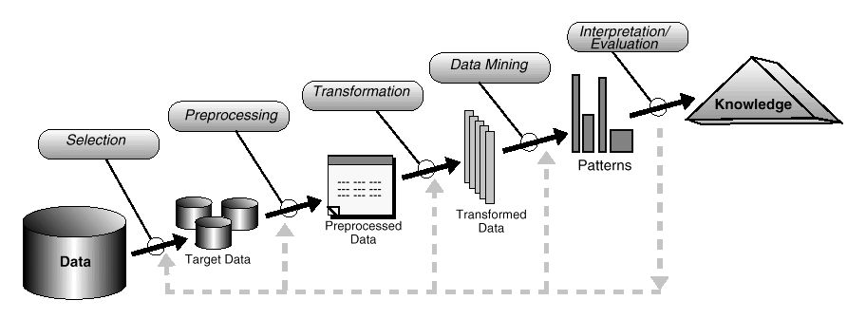

How to View Data as a Data Scientist?
Domain scientist

Slide 6
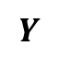

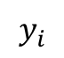
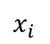
How to View Data as a Data Scientist?
Attributes
Object: also called sample, record, or instance
Attribute: property of object, also called covariate, field, feature
Dimension: the number of attributes in each object
Feature vector: multi-dimensional point in feature space
Sparsity: on attributes or objects
Noise: on attributes or objects
Objects
$$x_{i}$$
$$y_{i}$$
$$X$$
$$Y$$

Slide 7
Quiz 1
How many samples?
How many features?
What is the feature dimension?
How many classes?
Why called “dimension”?

Slide 8
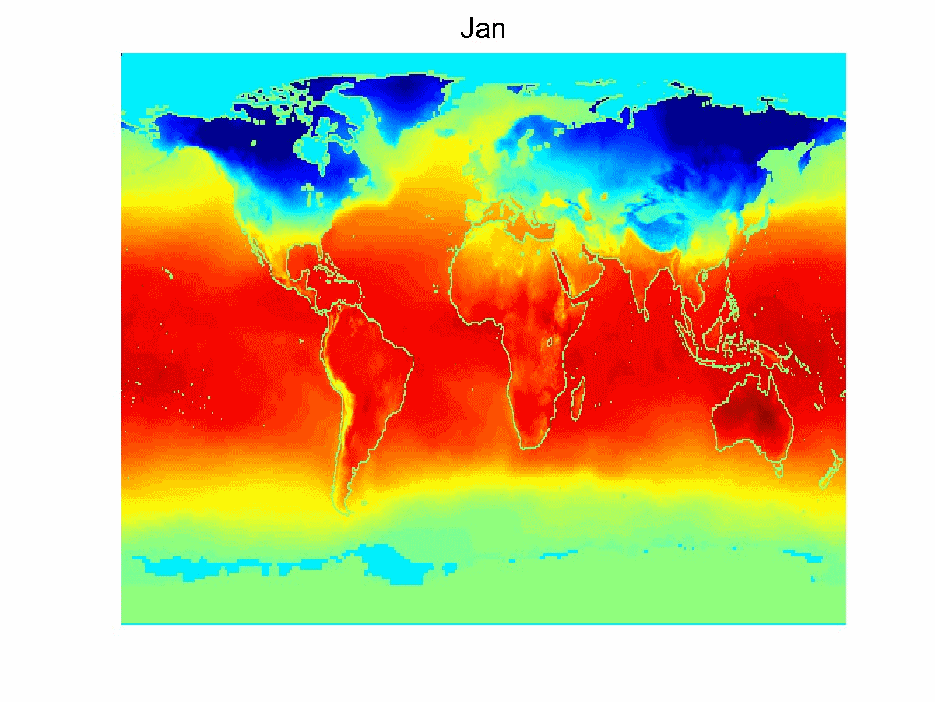
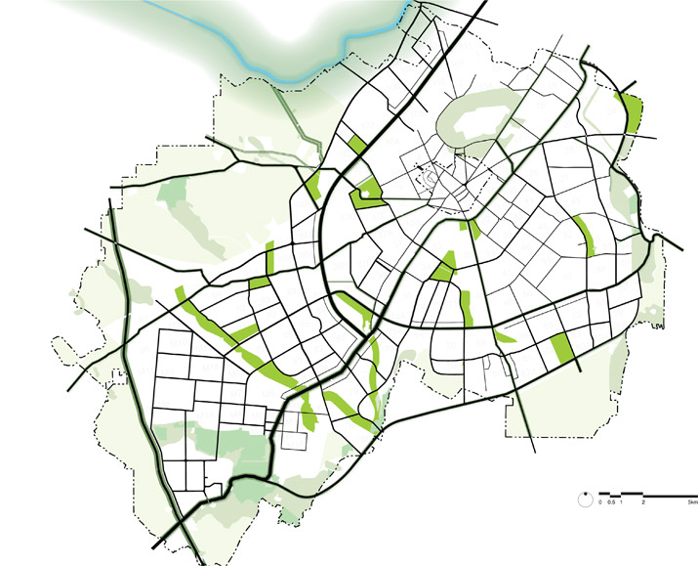
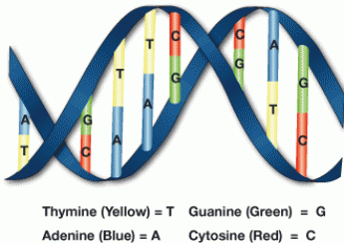
Types of Data by Structures
Table of records: no dependency structure (i.i.d.)
Graphs: road network, social network, the web
Spatial maps: earth imagery, disease map
Time series or sequences: DNA, voice
Semi-structured data: webpage, tweets
Attributes
?
Average Monthly Temperature of land and ocean
Objects
Json (XML)

Slide 9
Quiz: how to represent spatial or spatiotemporal data as samples?
Average Monthly Temperature of land and ocean

Slide 10
Attribute Type
Description
Examples
Operations
Nominal
The values of a nominal attribute are just different names, only enough to distinguish one object from another. (=, ≠)
zip codes, employee ID numbers, eye color, sex: {male, female}
mode, entropy, contingency correlation, χ² test
Ordinal
The values of an ordinal attribute provide enough information to order objects. (<, >)
hardness of minerals, {good, better, best}, grades, street numbers
median, percentiles, rank correlation, sign tests
Interval
For interval attributes, the differences between values are meaningful, i.e., a unit of measurement exists. (+, - )
calendar dates, temperature in Celsius or Fahrenheit
mean, standard deviation, Pearson's correlation, t and F tests
Ratio
For ratio variables, both differences and ratios are meaningful. (*, /)
temperature in Kelvin, monetary quantities, counts, age, mass, length, electrical current
geometric mean, harmonic mean, percent variation
Note: attribute types are determined by physical meaning, not by variable types in Python/C++.

Slide 11
Discrete/Continuous Attributes, Qualitative/Quantitative Attributes
Qualitative Attribute
Nominal and ordinal attributes
Quantitative Attribute
Interval and ratio attributes
Discrete Attribute
Finite or countably infinite set of values: e.g., zip codes, counts
Continuous Attribute
Real values: e.g., temperature, and height
Asymmetric Attribute
Only non-zero values are important: e.g., word frequency of a document, course list registered by a student

Slide 12
Quiz: Which types of attributes?
Nominal, ordinal, interval, ratio?
Quantitative or qualitative?
Discrete or continuous?
Symmetric or asymmetric?
Attributes
Objects

Slide 13
How to View Data as a Data Scientist?
Domain scientist

Slide 14

Data Collection Issues: Missing Data
Missing meta data
Attribute name, type, interpretation
How missing values are represented
Solution: Check with your data source!
Missing important attributes
For example, missing class labels
Solution: Check with your data source!
Missing attribute values
Very common, data collection mistake
Estimate values
Remove those records
Ignore missing values
Height (m) | Weight (lb) | Age (Yr) | Income ($k)
Disease Yes / No
1.70 | 150 | 25 | 50
1.75 | 180 | 999 | 30
1.60 | 130 | 11 | 0
No
Yes
No

Slide 15
Data Collection Issues: Noise
Noise refers to modification of original values
Examples: distortion of a person’s voice when talking on a poor phone and “snow” on television screen
Sources of Noise in Data Collection
Measurement Errors: Errors introduced by imperfections in the measurement instruments or processes.
Environmental Interference: External factors affecting data collection, such as environmental conditions or background noise.
Human Errors: Mistakes made by individuals during data entry, recording, or processing.

Slide 16
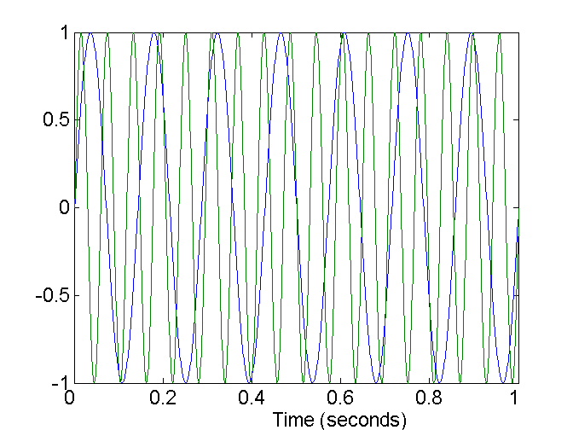
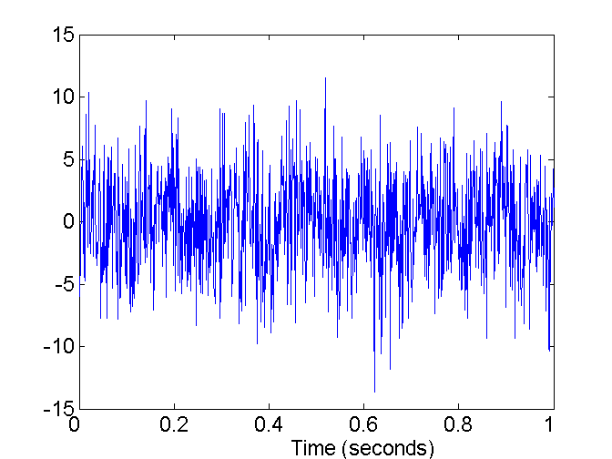
Data Collection Issues: Noise
Solution: filter out noise, design robust algorithms
Two Sine Waves
Two Sine Waves + Noise

Slide 17

Other Data Collection Issues
Errors, inconsistency, redundant or duplicate data
Happens when merging data from heterogeneous sources
Examples: same person with multiple names (William/Bill)
Solution: data cleaning
Tedious and time consuming
Some scripts may help
May need to choose different data

Slide 18
How to View Data as a Data Scientist?
Domain scientist

Slide 19
Application Related Issues: Sampling
Why sampling: entire data is too expensive or time consuming to collect or process.
Key Principle: samples representative of population (WHY?)
Common sampling methods:
Simple random sampling
Stratified sampling (class balance issues)
Clustered sampling
Systematic (clustered) sampling
*
Simple random sampling
Stratified sampling
Clustered sampling
Systematic clustered sampling

Slide 20

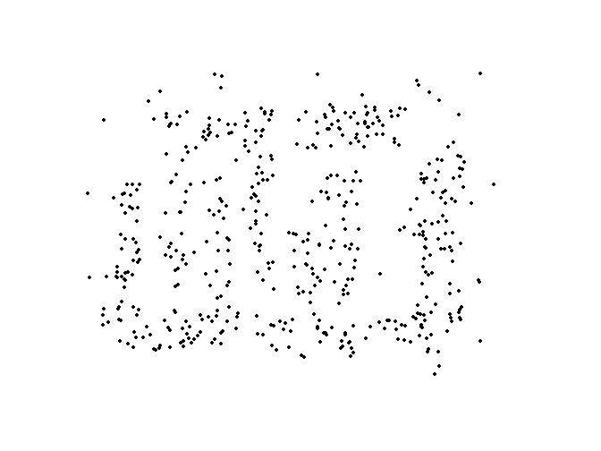
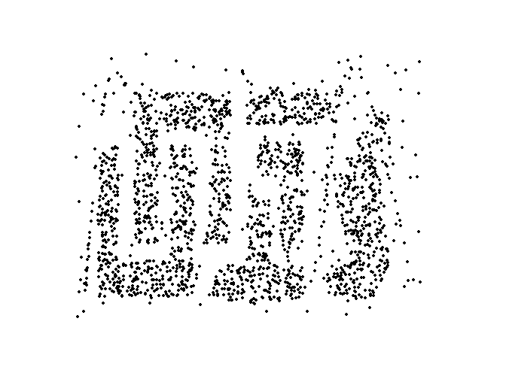
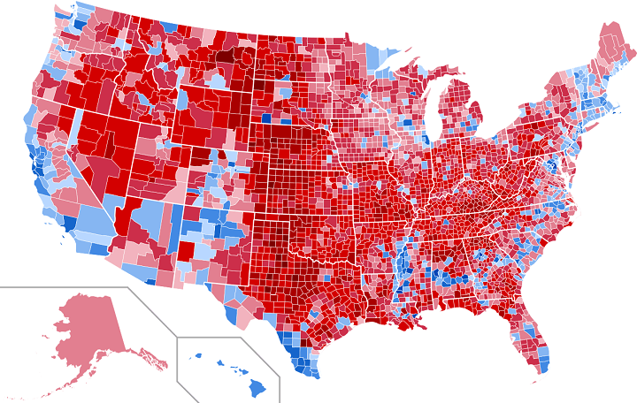
Application Related Issues: Sampling
Common mistakes related with sampling
Insufficient number of samples to reveal patterns
Samples are biased towards some sub-group
8000 points
2000 points
500 points
Selected threshold
Best threshold
2016 election result by counties
2016 election result by States

Slide 21
Feature Transformation
Scenario 1: Predicting Housing Prices
Dataset has the following features:
Square Footage (in hundreds of square feet)
Year Built (year the house was constructed)
Price (in thousands of dollars)
Square Footage | Year Built | Price
2000 | 1995 | 35,000
1500 | 2005 | 30,000
1900 | 2000 | 40,000
Difference in scales !!!

Slide 22
Simple functions: x^{k}, log(x), e^{x}, |x|
Standardization and Normalization
Goal: unify value ranges for features
(x – μ) / σ, subtract mean, divided by standard deviation
Or, (x-min)/(max-min)
Avoid impacts of outliers
Use median instead of mean
Use absolute standard deviation
Question: what transformation to use?

Slide 23
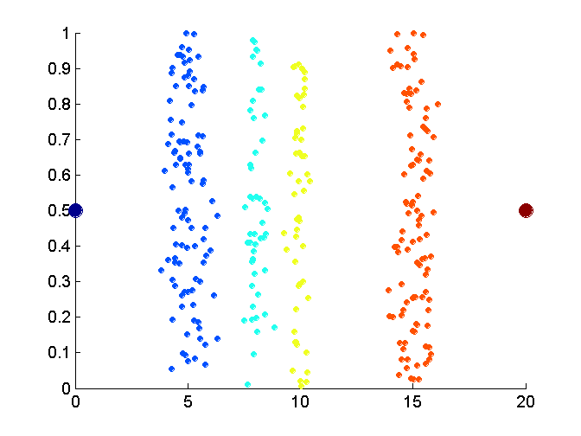
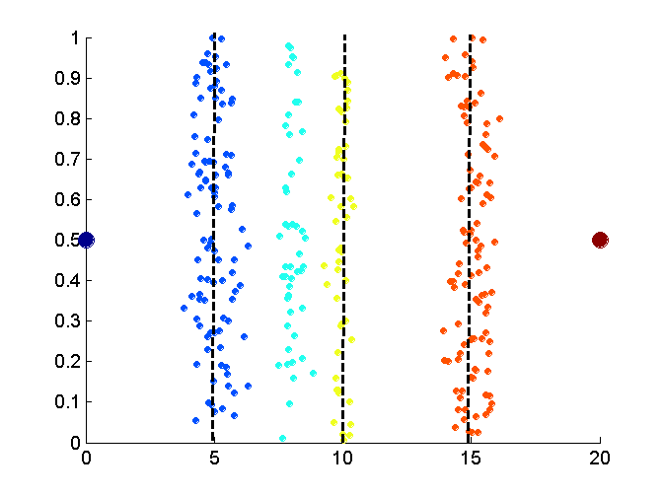
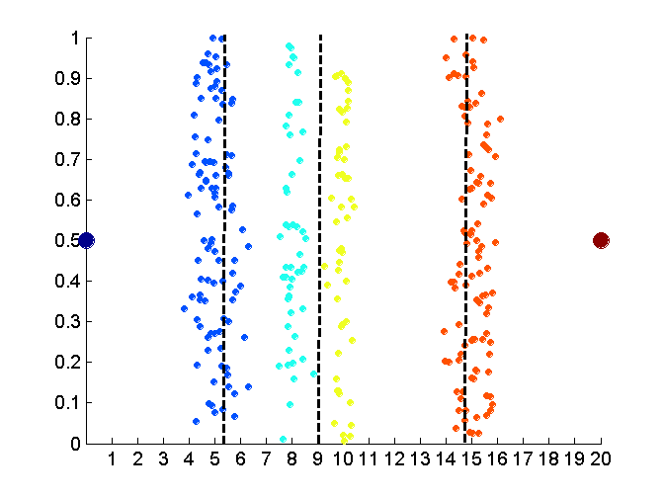
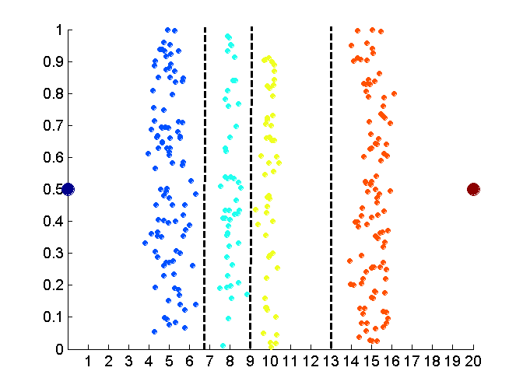
Discretization Continuous Attributes
?
Data
Equal interval width
Equal frequency (Percentile)
K-means clustering

Slide 24
Questions?

Slide 25
Feature Engineering
Reminder: what is feature?

Slide 26
Feature Selection, Extraction, and Engineering
Why preprocessing features?
Good features + simple model = Good result
Features in raw data often not good
Issues:
Too many features (dimensionality reduction)
Features not effective in task (handcraft feature, feature engineering)
Too hard to handcraft features (feature learning, deep learning)

Slide 27
Scenario 2 : Customer Purchase Prediction
Customer ID | Monthly Income | Annual Income | Number of Purchases Last Year | Average Purchase Amount | Age | Total Expenditure
1 | $3,000 | $36,000 | 5 | $50 | 28 | $250
2 | $4,500 | $54,000 | 8 | $70 | 35 | $560
3 | $2,800 | $33,000 | 3 | $40 | 40 | $120
4 | $5,300 | $62,000 | 12 | $90 | 30 | $1080
5 | $3,500 | $43,000 | 6 | $60 | 25 | $360
Which Features are Redundant?
Monthly Income and Annual Income
Total Expenditure and Number of Purchases Last Year

Slide 28
Porcupine Problem
The "Porcupine Problem" is a metaphor used to describe a challenge related to the curse of dimensionality in high-dimensional spaces.
Imagine a high-dimensional unit sphere (like a sphere in 3D, but extended to more dimensions).
As the number of dimensions increases, almost all the volume of the sphere becomes concentrated near the surface, rather than in the center.
Data points in high-dimensional space tend to lie near the surface of this "sphere," with the effect that they resemble the spines of a porcupine, sticking out in all directions.

Slide 29
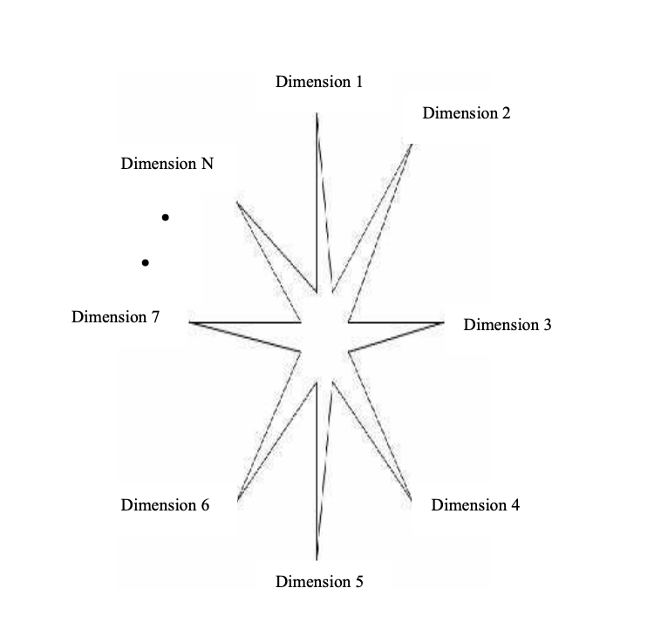
This geometric property implies that in high-dimensional spaces, almost all points are "far away" from each other, and the notion of "nearest neighbors" becomes less meaningful.
Shanmugapriya, B. "Clustering Algorithms for High Dimensional Data–A Review." International Journal of Computer Science and Information Security (IJCSIS) 15.5 (2017).

Slide 30
Issue 1: Curse of dimensionality
Reminder: what is “feature dimension”?
When feature dimension is very high:
Hard to visualize data!
Euclidean distance less meaningful!
Data becomes increasingly sparse in feature space!
Python demo on Euclidean distance in high dimension
Volume increase exponentially with dimension
Given same number of points, density inversely proportional to volume

Slide 31
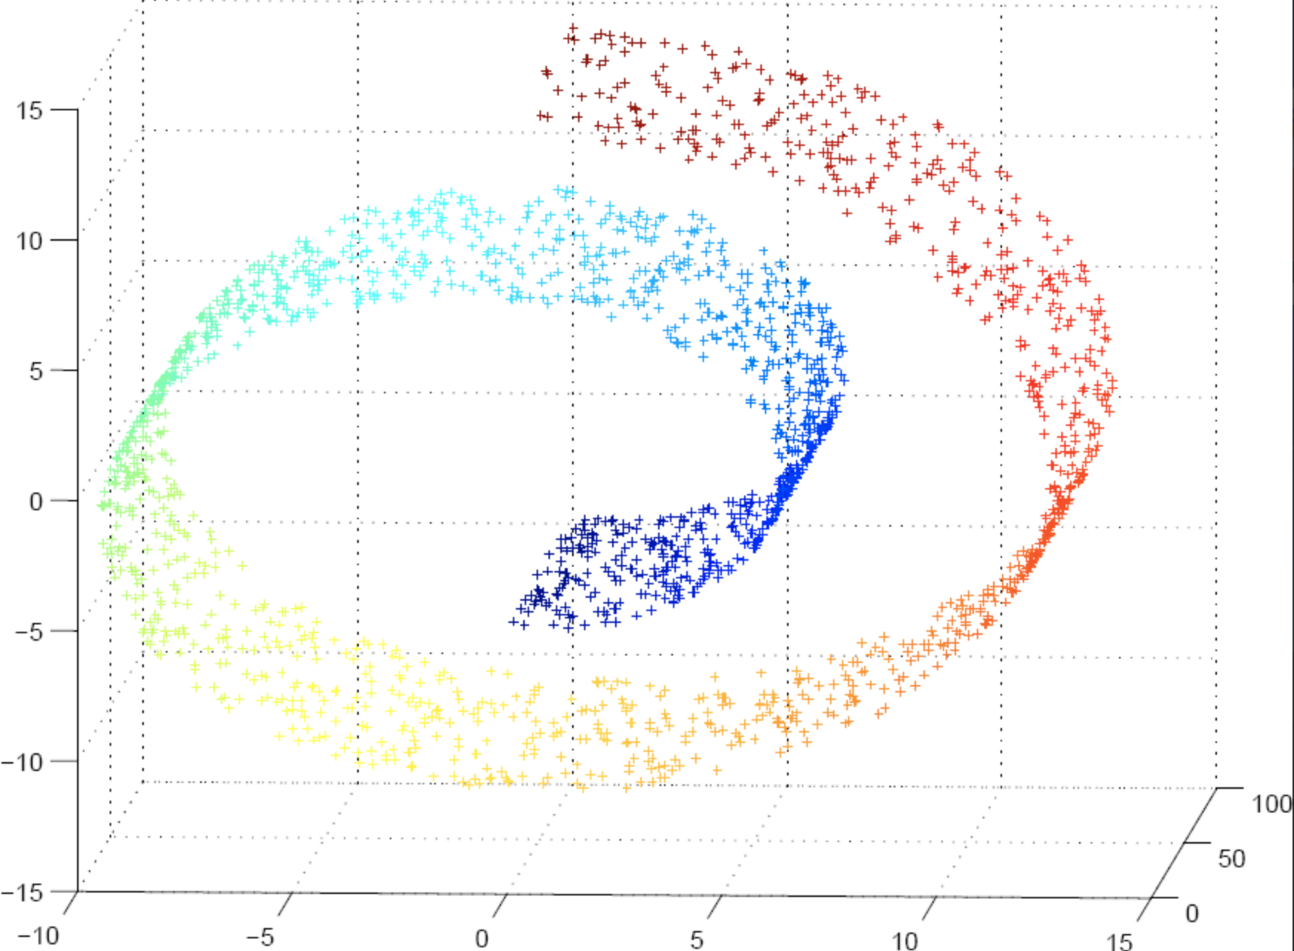
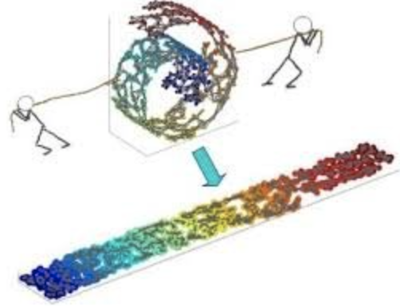
A
B
A
B
(From google image)

Slide 32
Dimensionality Reduction
Purpose:
Avoid curse of dimensionality
Reduce amount of time and memory required
Eliminate irrelevant features or reduce noise
Easier for visualization
Common techniques
Principle Component Analysis (PCA)
Manifold learning
… ...

Slide 33
Dimensionality Reduction: PCA
Goal is to find a projection that captures the largest amount of variation in data
Eigenvectors of the covariance matrix as basis
x₂ (weight)
e₂
e₁
We will discuss more on PCA later!
x₁ (height)
Notes:
Intuition: projection, variance, reducing redundancy and removing noise
Eigenvector decomposition, linear transformation

Slide 34
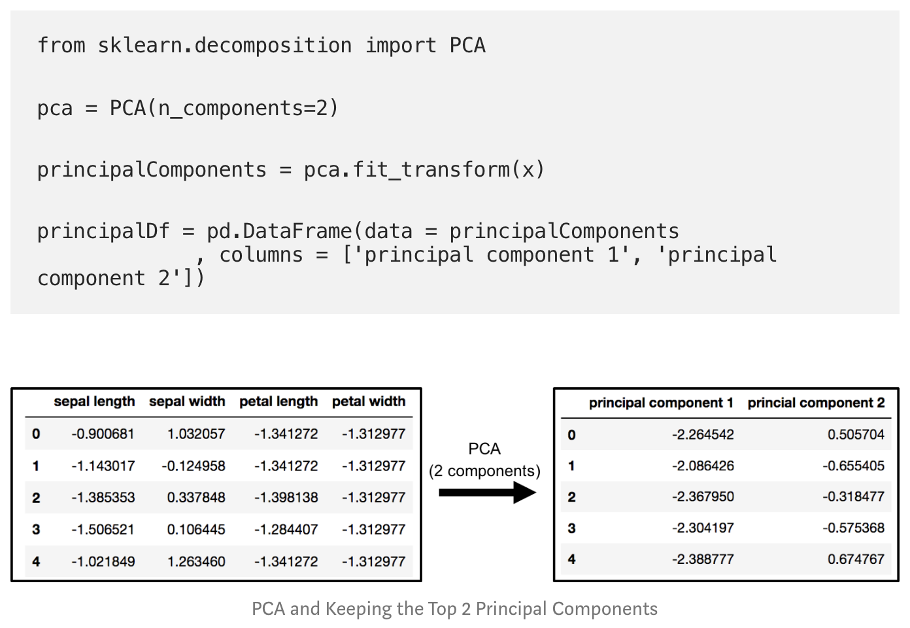
Python Example
Try your self as take-home exercise!
(https://towardsdatascience.com/pca-using-python-scikit-learn-e653f8989e60)

Slide 35








1
5
10
15
20
100
250

Slide 36
Feature Subset Selection
Techniques: select one feature each step
Filter approaches:
Features are selected before data mining algorithm is run
Example: mutual information
Embedded approaches:
Feature selection occurs naturally as part of data mining algorithm
Examples: decision tree, Lasso
Question: pros and cons compared with PCA?

Slide 37
Feature Engineering
When raw attribute (features) not indicative
Common approaches
Feature extraction: creating new features from raw data
Feature transformation: mapping features to new space
In many applications, features are more important than algorithms
However, feature engineering is often application specific, requires domain knowledge
(Please read KDD Cup reports for examples)

Slide 38
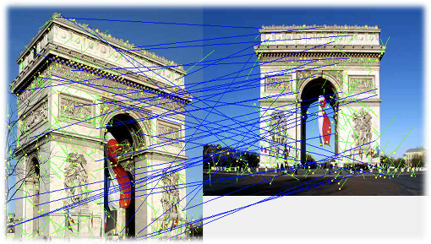
Feature Extraction
Consider the application of computer vision
Raw pixel color are often not informative
Features like edge, corner, orientation are more useful
Scale-invariant feature transform (SIFT)
Semantic gap issues!
(From google image)

Slide 39
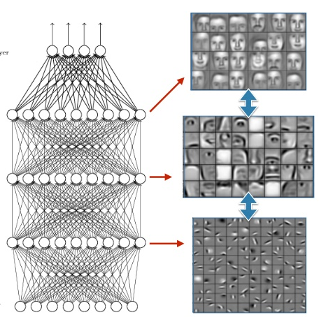
Automatic Feature Extraction: Deep learning (End-to-End)
Big training data + faster computer
Advantages:
Automatically extract advanced features in layers
Bridge semantic gaps
Surprisingly good performance
Disadvantage:
Black box, interpretability
Parameter tuning
Real world impacts:
Automatic driving
Face recognition
(from Google image)

Slide 40
Questions?

Slide 41
Theoretical Aspects of PCA
(Extra Topic Beyond Scope)

Slide 42
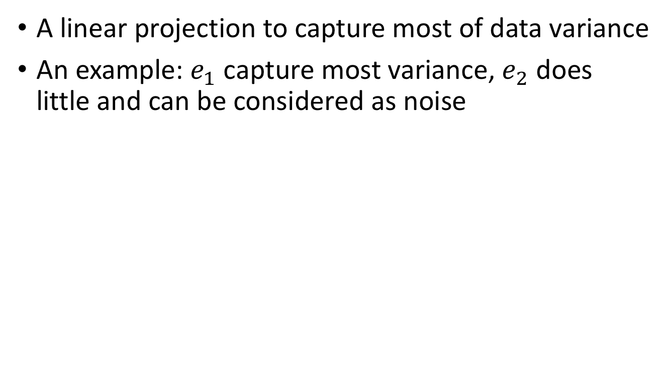
Principle Component Analysis (PCA)
A linear projection to capture most of data variance
An example: $e_{1}$ capture most variance, $e_{2}$ does little and can be considered as noise
x₂ (weight)
e₂
e₁
x₁ (height)

Slide 43
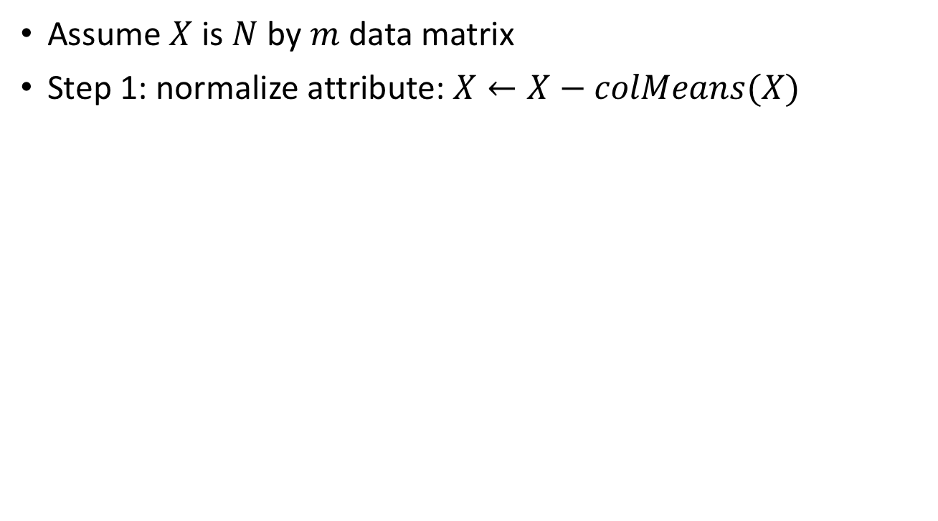
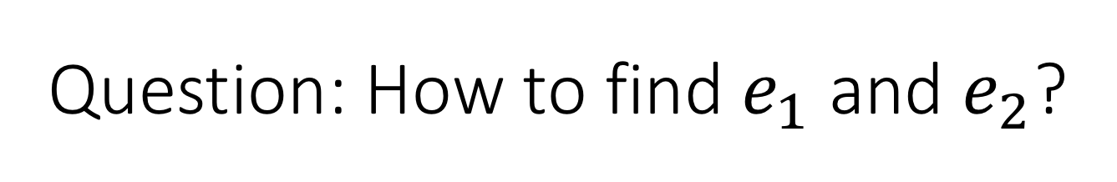
Question: How to find $e_{1}$ and $e_{2}$?
Assume $X$ is $N$ by $m$ data matrix
Step 1: normalize attribute: $X←X−colMeans(X)$
x₂ (weight)
x₂ (weight)
e₁
e₂
e₁
e₂
x₁ (height)
x₁ (height)

Slide 44
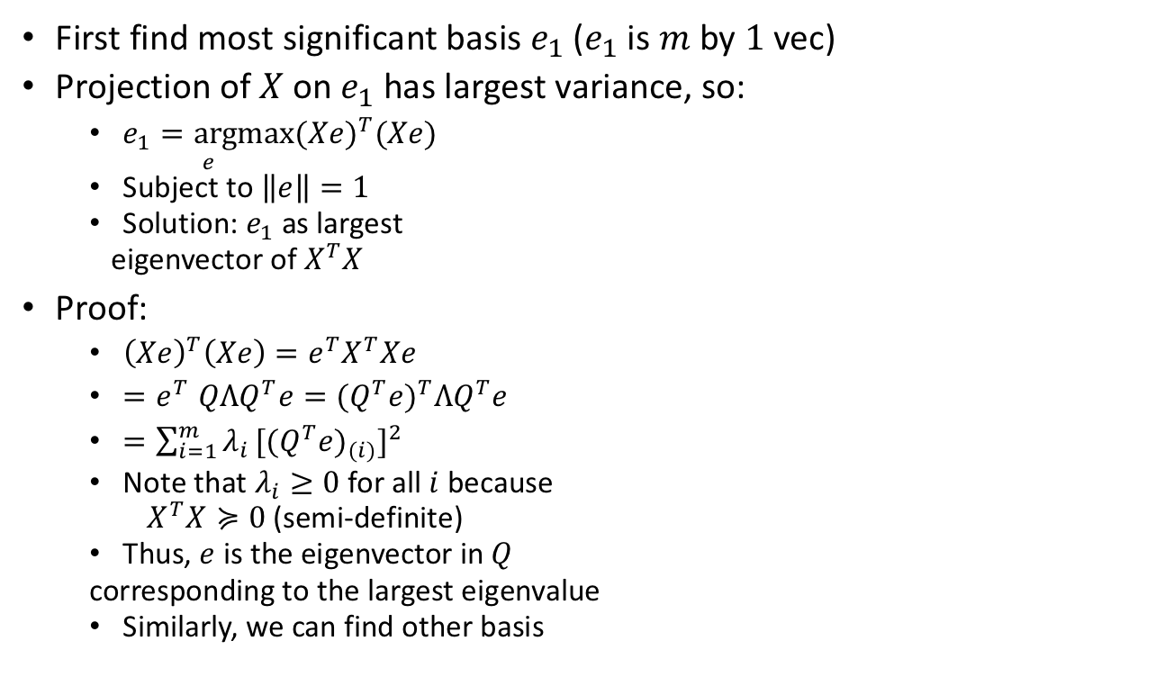
Question: How to find $e_{1}$ and $e_{2}$?
First find most significant basis $e_{1}$ ($e_{1}$ is $m$ by $1$ vec)
Projection of $X$ on $e_{1}$ has largest variance, so:
$\underset{e}{e_{1}=argmax}{{(Xe)}^{T}(Xe)}$
Subject to $\left\|e\right\|=1$
Solution: $e_{1}$ as largest
eigenvector of $X^{T}X$
Proof:
${\left(Xe\right)}^{T}\left(Xe\right)=e^{T}X^{T}Xe$
${=e}^{T}QΛQ^{T}e={(Q^{T}e)}^{T}ΛQ^{T}e$
$=\sum_{i=1}^{m}{λ_{i}}{{[(Q^{T}e)}_{(i)}]}^{2}$
Note that $λ_{i}≥0$ for all $i$ because
$X^{T}X≽0$ (semi-definite)
Thus, $e$ is the eigenvector in $Q$
corresponding to the largest eigenvalue
Similarly, we can find other basis
x₂ (weight)
e₂
e₁
x₁ (height)

Slide 45
Using PCA
Reduce dimension for “curse of dimensionality”
Data compression
Removing noise
x₂ (weight)
e₂
e₁
Python: scikit-learn package
x₁ (height)

Slide 46
Use Case 1: Dimensionality Reduction
Hyper-spectral image classification
Each pixel is a sample, containing 200 features, and one class label
Run logistic regression classifier
Case 1: Using all 200 features
Case 2: Using a sub-set of 200 features based on PCA

Slide 47
Use Case 2: Compression
How to recover the matrix after compression?
Image compression
Each column is a data sample
Redundancy (correlation) exists between features
Idea:
X’
X
Q
Columns are eigenvectors
Each row is projected feature vector of one sample
Each row is feature vector of one sample

Slide 48
Use Case 2: Compression
Demo:
Image compression with different number of components (Miss Lena)

